Slide 1
CAR Administration Overview
Module 4 – Corrective Action Plans and Milestones

Slide 2
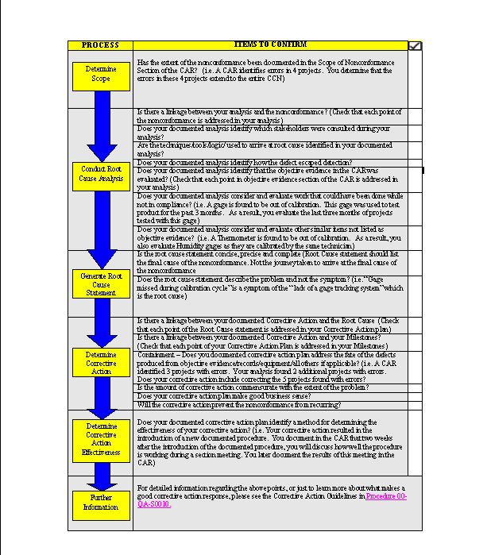
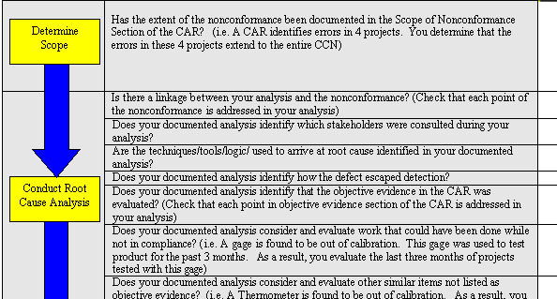
Job Aid –
Checklist for CAR Administrators and Owners
This Job Aid was developed to be used as a tool to help the CAR Owner and CAR Administrator ensure that all elements of the root cause analysis and corrective action plan are included in the CAR responses.
*Job Aid Checklist Items: Are identified in this presentation by this box.

Slide 3
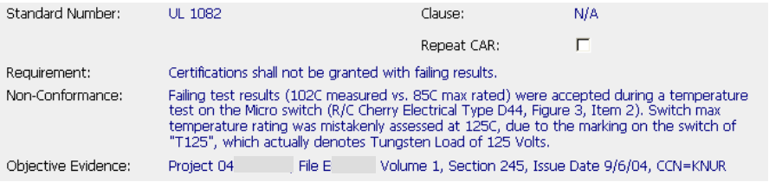
Setting expectations – Corrective Action Plans
What was done with the defective project? – Resolve the evidence
How widespread is the problem? – Scope of the problem
Are there any other projects with the same problem? – Exposure
Why did this happen? – Root Cause Analysis
5. How did this happen? – Detection
6. What can be done to stop this problem immediately? – Containment
7. What actions will be taken so this will not happen again? – Prevention
8. How will you know the solutions were successful? – Verification
How will you know it will not happen again? – Controls

Slide 4
Corrective Action Plans –
Resolving Past Defects
What was done with the defective project? – Resolve the evidence
How widespread is the problem? – Scope of the problem
Are there any other projects with the same problem? – Exposure
Why did this happen? – Root Cause Analysis
5. How did this happen? – Detection
6. What can be done to stop this problem immediately? – Containment
7. What actions will be taken so this will not happen again? – Prevention
8. How will you know the solutions were successful? – Verification
How will you know it will not happen again? – Controls
‘Cleaning up the mess’ does not prevent recurrence

Slide 5
Corrective Action Plans –
Containing Defects
What was done with the defective project? – Resolve the evidence
How widespread is the problem? – Scope of the problem
Are there any other projects with the same problem? – Exposure
Why did this happen? – Root Cause Analysis
5. How did this happen? – Detection
6. What can be done to stop this problem immediately? – Containment
7. What actions will be taken so this will not happen again? – Prevention
8. How will you know the solutions were successful? – Verification
How will you know it will not happen again? – Controls
A recent evaluation showed that 40% of accreditor-generated CARs listed no containment activities!

Slide 6
Corrective Action Plans –
Prevention
What was done with the defective project? – Resolve the evidence
How widespread is the problem? – Scope of the problem
Are there any other projects with the same problem? – Exposure
Why did this happen? – Root Cause Analysis
5. How did this happen? – Detection
6. What can be done to stop this problem immediately? – Containment
7. What actions will be taken so this will not happen again? – Prevention
8. How will you know the solutions were successful? – Verification
How will you know it will not happen again? – Controls
Preventive actions that cover:
  The scope of the problem
  Means to determine success
  Controls to prevent recurrence

Slide 7
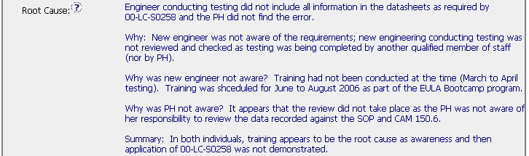

Linkage – Root Cause to Corrective Actions
All elements of the Root Cause should be addressed by the plan
*Job Aid Checklist Item: “Is there a linkage between your documented Corrective Action and the Root Cause?”

Slide 8
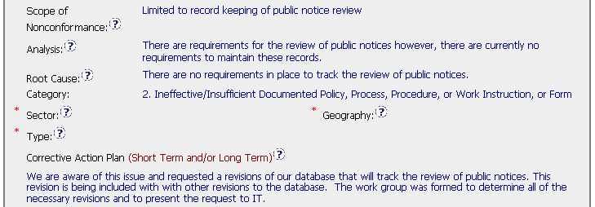
Corrective Action Plans
Does the plan cover the scope of the nonconformance?
Global problems require global solutions, local problems require local solutions.
*Job Aid Checklist Item: “Is the amount of corrective action commensurate with the extent of the problem?”

Slide 9
Resolving records cited in
Objective Evidence

Slide 10


Resolving records –
Examples of Good Practices
Examples of corrected records
Indicates that past records will not be modified
*Job Aid Checklist Item: “Does your documented corrective action plan address the fate of the defects?”

Slide 11
Containment

Slide 12
Containment
Describes the actions to stop the generation or escape of further defects until the long-term solution is implemented
Possible Containment:
None is needed (with explanation, may be described in Analysis)
Description of the specific containment activities
    Corrective Action Plan narrative
    Specific Milestone for completion of containment actions

Slide 13

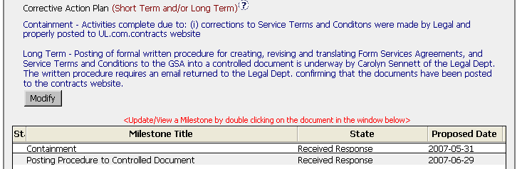
Containment –
Examples of Good Practices
The Corrective Action Plan can describe containment . . .
. . . or the Analysis can show list the reasons why containment is not needed
Note specific containment AND a corresponding milestone

Slide 14
Prevention and Controls

Slide 15
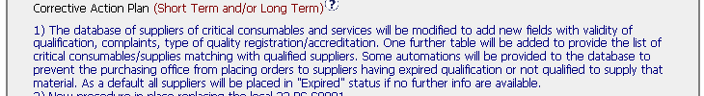
Prevention, controls, effectiveness –
Good Practices
1
2
3
*Job Aid Checklist Item: “Will the corrective action plan prevent the nonconformance from recurring?”
“Does your documented corrective action plan identify a method for determining the effectiveness of your corrective action?”

Slide 16

Prevention –
Some “not as good” Practices
A
B
C
D

Slide 17
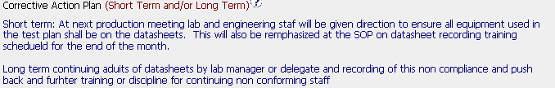
Evaluate these plans
A
B

Slide 18
Evaluate these plans
What was done with the nonconforming records?
A
Containment
Good long-term, details may be in milestones
B
Addresses the objective evidence. . .
. . .but what prevents recurrence?

Slide 19


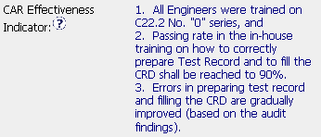




CAR Effectiveness Indicator
CAR Effectiveness Indicator: Describes how the effectiveness of the corrective actions will be measured and judged. Field is located below Milestones.
Watch Out!
Is there something the CAR Owner can do to verify effectiveness before the next internal audit?

Slide 20
Milestones

Slide 21
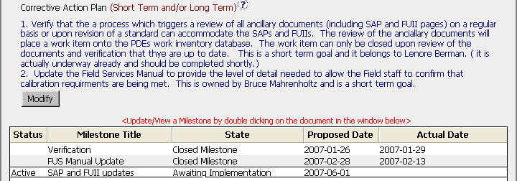
Milestones – Linkage to Corrective Action Plan
Every element of the Corrective Action Plan has corresponding milestone(s)
*Job Aid Checklist Item: “Is there a linkage between your documented Corrective Action and your Milestones?”

Slide 22
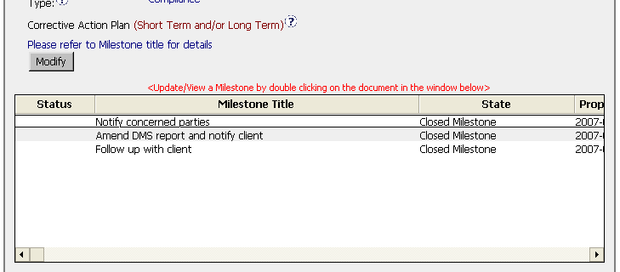
Acceptable Alternative
Provide notation in the Corrective Action Plan to refer to the Milestones for details

Slide 23
Granting Extensions
SHORT CHECKLIST
Has the Owner done work on the CAR?
Is there a legitimate reason for the need for extension?
Are there containment actions in place to contain new defects during the extension period?
Has the CAR been extended before? Is the request for more than 30 days delay? – This requires QEM approval.
Exercise: Acceptable or Unacceptable?
a) Reason - In process of collecting input from DEs. Delay due to workload/involvement in file review.
b) Reason - Other priorities have prevented me from addressing
c) Reason - The LPG has been written and submitted for approval and publication. Once it is published this milestone will be completed.
d) Reason - Still waiting for IT to provide comments on the database. Most recent voicemail update is that they require at least 1 more month

Slide 24

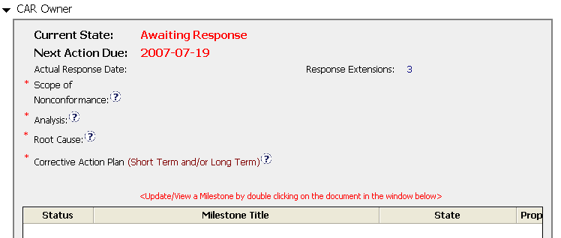

Granting Response Extension –
More than three or 30 days or more
Requests more than 30 days
In both situations: The next Response extension requires Jim Oates’ Approval
Has had 3 Response Extensions

Slide 25
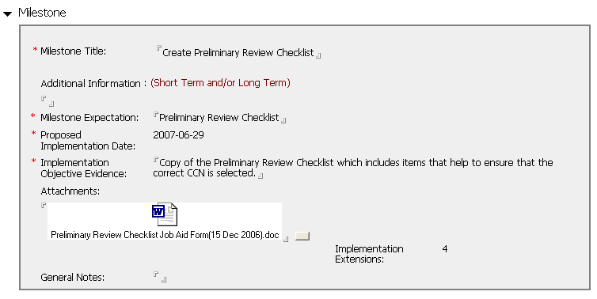



Granting Implementation Extension –
More than three or 30 days or more
Milestone has had 3 Implementation Extensions
In both situations: The next Implementation extension requires Jim Oates’ Approval
Requests more than 30 days

Slide 26
Corrective Action Summary
  Should address any necessary short-term containment actions as well as long-term actions to prevent recurrence
  Should be commensurate with the severity of the nonconformance (sanity check)
    Does the solution appear to make good business sense?
    Is the scope of the plan appropriate for the type and scope of the CAR?
  Consider opportunities to mistake-proof the process.
  Describe controls and means to determine effectiveness (use the CAR Effectiveness Indicator field)
  Linkage!
  Avoid: Solutions that are emails, punitive against individuals, or one-time events

Slide 27
Extensions Recap
Require a valid reason
After third, requires Jim Oates’ approval
Any single extension request for more than 30 days requires Jim Oates’ approval

Slide 28
End of Module 4
Revision 1.0 – Version presented to EULA team June 2007, complies with 00-QA-S0010 Issue 6.0 and 00-QA-J0029 Issue 1.0.

